Slide 1

Project 8: On joint parameterizations of linear and nonlinear functionals in neural networks
Tutor: Dominique PASTOR
Ayoub DAMAK - Wassim CHAKROUN

Slide 2
Generalities
Main idea
Previous activation functions
Proposed activation functions
Optimizers & Loss functions
Test benches
Takeaway messages
Table of contents
Notes:
Summary (fi kelmtin chniya innov)
Proposed functions (RePSU w 5wetha)
Math (ehh njemo n7otouh nejmo la
Test benches (shallow, deep, transfer,...)
Our progress (code collab)

Slide 3
Generalities
Artificial Neuron
wn: Weight
b: Bias
f: Activation Function
Learnable Parameters
Static Function
x1
w1
x2
w2
x3
w3
∑
f
Y
wn
b
xn

Slide 4

Main idea
- Sigmoid & ReLU are non-parametric nonlinear activation functions of the early-stage neural transfer functions
- The nonlinear new class of Rectified Parametric Sigmoid Units (RePSU) inherits from their best qualities
- By using a joint parameterization, a neural network can capture both linear and nonlinear relationships within the data, leading to improved model accuracy, better performance and a faster execution time
Notes:
many real-world problems require a combination of linear and nonlinear functions to be modeled effectively: image classification / speech recognition / financial forecasting / predictive maintenance

Slide 5
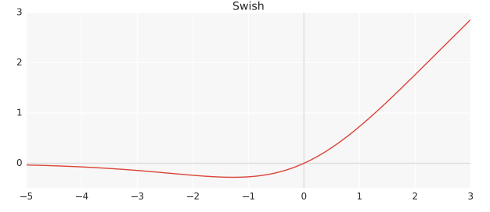
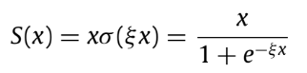
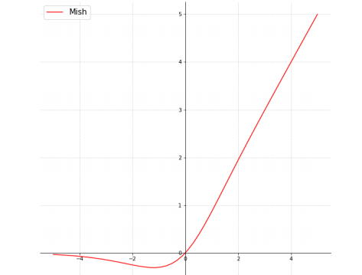
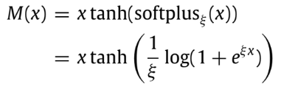
Previous (non-parametric/parametric) activation functions
SWISH/PSWISH
MISH/PMISH
Notes:
https://krutikabapat.github.io/Swish-Vs-Mish-Latest-Activation-Functions/
Swish and Mish are smooth and nonmonotonic which makes them different from most common activation functions
Swish and Mish are unbounded above and bounded below.
Being unbounded above is a desirable property for any activation function since it avoids saturation which generally causes training to drastically slow down due to near-zero gradients.
Being bounded below is also advantageous because it results in strong regularization effects and reduces overfitting.

Slide 6
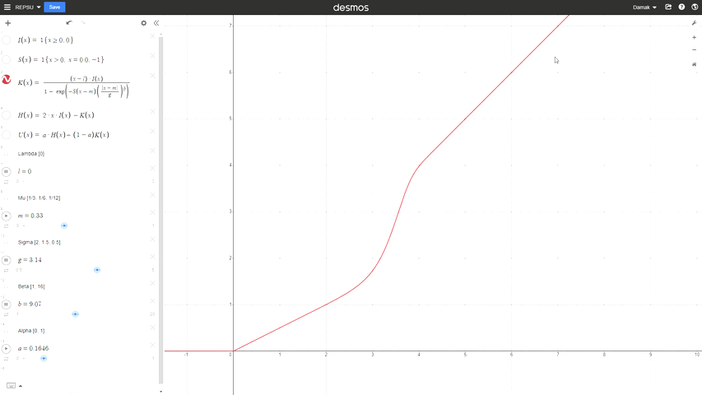
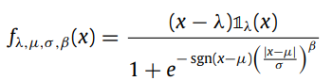

Proposed (parametric) activation functions
RePSKU (RePSU▽)
Notes:
The analytic form of this new neural class involves scale, shift and shape parameters to obtain a wide range of activation shapes, including the standard rectified linear unit (ReLU) as a limit case.

Slide 7

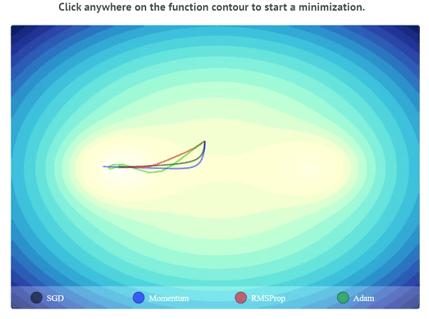
Optimizers
Optimizers are used to minimize the loss function during training.
There are several differences between optimizers including:
Update rule: Some optimizers use momentum, while others use adaptive learning rates or a combination of both.
Learning rate: Different optimizers have different ways of adapting the learning rate, such as using a fixed rate, adaptive rate, or a schedule.
Optimizers also differ in their memory requirements, convergence rates, robustness to noise, computation efficiency, and hyperparameters.
Notes:
- Optimizers in deep learning are used to minimize the loss function during training.
- They adjust the weights and biases of the neural network to improve its performance on the task at hand.
- Optimizers use various algorithms to find the optimal values of these parameters.
- They update the parameters iteratively based on the gradients of the loss function with respect to them.
- The choice of optimizer can have a significant impact on the training time, convergence, and accuracy of the model.
There are several differences between optimizers that can impact their performance and suitability for different types of deep learning tasks. Here are some of the key differences:
Update rule: Each optimizer has a different update rule for adjusting the weights and biases of the neural network during training. Some optimizers use momentum, while others use adaptive learning rates or a combination of both.
–Momentum technique accumulates gradients from previous iterations and adds them to the current iteration, which helps to smooth out fluctuations in the gradient and speed up convergence. In this way, momentum can help the optimizer to escape local minima and reach the global minimum faster.
–Adaptive learning rate optimizers adjust the learning rate according to the magnitude of the gradients. If the gradients are large, the learning rate is decreased, and if the gradients are small, the learning rate is increased. This helps to prevent overshooting the minimum and can improve the convergence speed and accuracy.
Learning rate: The learning rate determines the step size taken in the direction of the gradient during each update. Different optimizers have different ways of adapting the learning rate, such as using a fixed rate, adaptive rate, or a schedule.

Slide 8
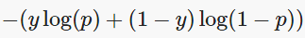
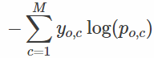
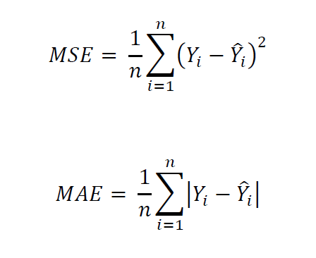
Loss functions
Loss functions are used to capture the difference between the actual and predicted values.
Loss functions are mainly classified into two different categories: Classification loss and Regression loss.
Classification losses:
* (Binary) Cross-Entropy: the most commonly used loss function for classification problems.
* Categorical Cross-Entropy: for multi-class classification problems where the classes are not mutually exclusive.
Regression losses:
* Mean Squared Error (MSE): the most commonly used loss function for regression problems.
* Mean Absolute Error (MAE): this measures the average absolute difference between the predicted and actual values.
Notes:
* Categorical: we calculate a separate loss for each class label per observation and sum the result.
M - number of classes / log - the natural log / y - binary indicator (0 or 1) if class label c is the correct classification for observation o / p - predicted probability of observation o from class c
The classes are not mutually exclusive, meaning that an instance may belong to more than one class.
*MSE measures the average squared difference between the predicted and actual values. MSE is particularly useful when large errors are particularly bad, because it strongly penalizes large differences between the predicted and actual values. Therefore, MSE is often used in applications where the goal is to minimize the magnitude of the errors.
*On the other hand, MAE measures the average absolute difference between the predicted and actual values. It is less sensitive to outliers than MSE, because it does not square the differences. MAE is often used in applications where small errors are considered acceptable.

Slide 9
Test benches
Shallow CNN-1-X
Deep CNN-2-Y
Shallow Ensemble Learning SEL-Z
Deep Ensemble Learning DEL-Z
Y ∈ {ReLU, RePSU, MISH, PMISH, SWISH, PSWISH}
X ∈ {ReLU, RePSU▽, MISH, PMISH, SWISH, PSWISH}
Z ∈ {ReLU, PMISH, PSWISH, RePSU▽}
Z ∈ {ReLU, PMISH, PSWISH, RePSU▽}
Notes:
shrinkage is the reduction in the effects of sampling variation

Slide 10
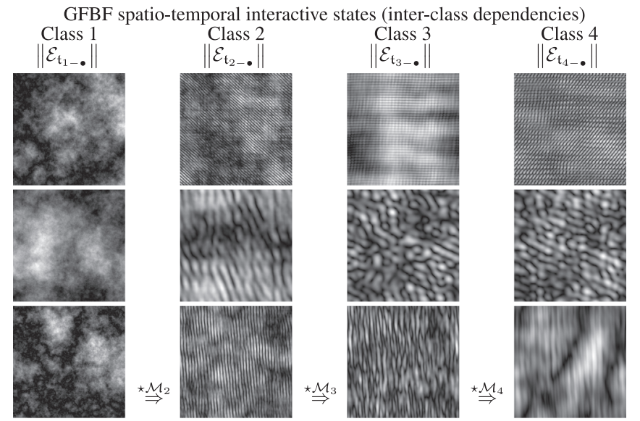
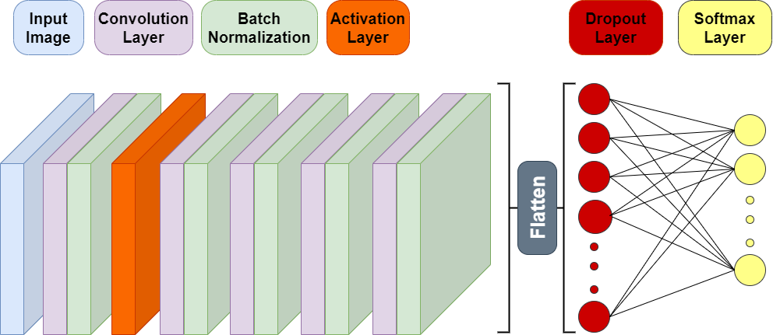
Deep CNN
Generalized Fractional Brownian Texture Dataset
Model Architecture
Notes:
Differences between our implementation and the paper (all data used? / layers? / optimizer?/ initialization?)

Slide 11
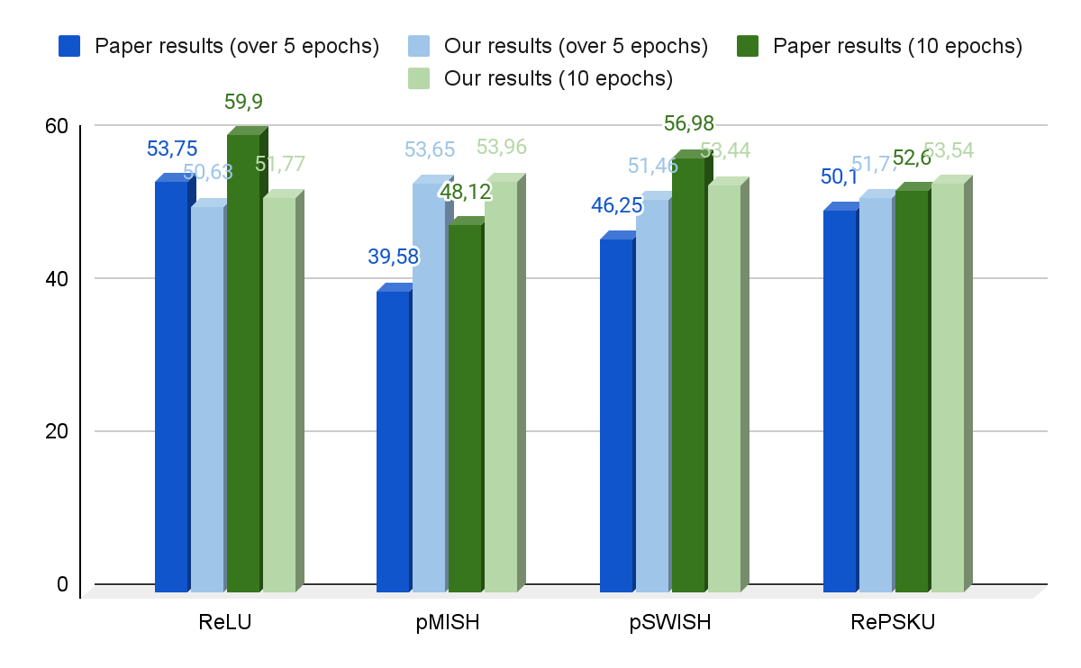
Deep CNN - Results
Challenges
Input Shape
→ Size reduction
Overfitting
→ Dropout layer
Notes:
Differences between our implementation and the paper (all data used? / layers? / optimizer?/ initialization?)

Slide 12
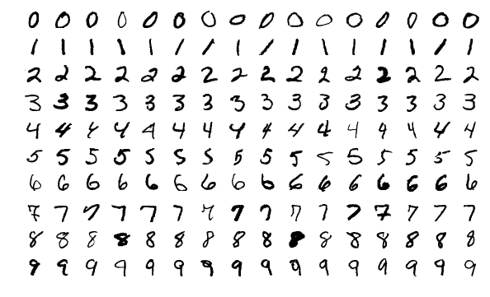
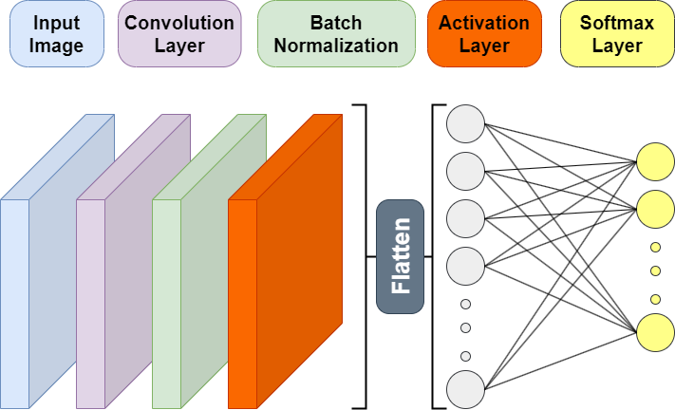
Shallow CNN
MNIST Dataset
Model Architecture
Notes:
Differences between our implementation and the paper (all data used? / layers? / optimizer?/ initialization?)

Slide 13
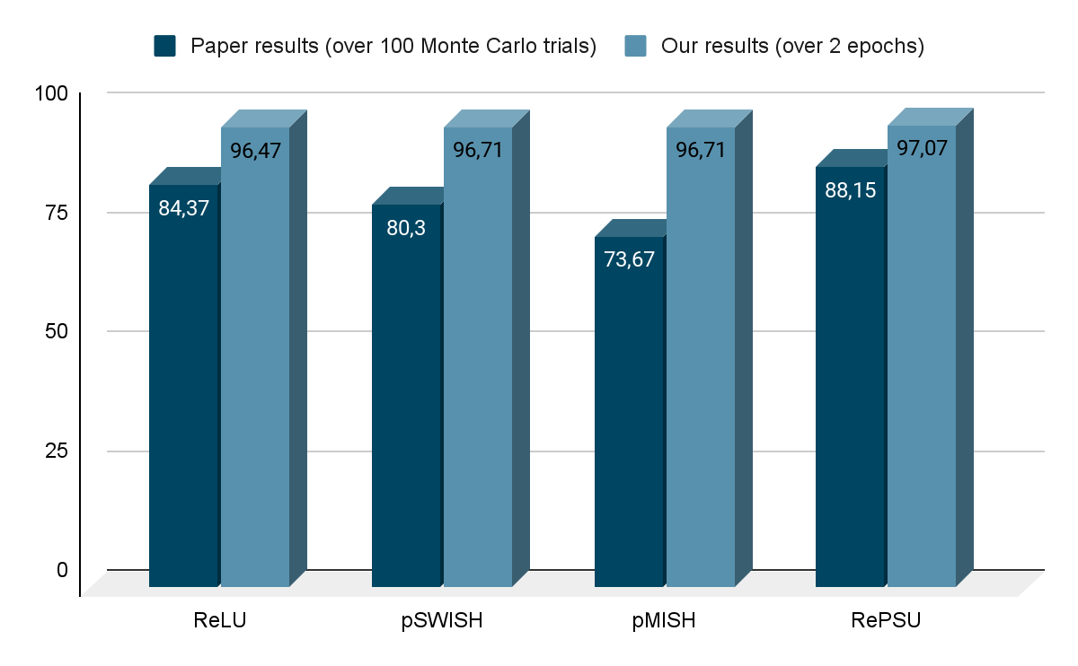
Shallow CNN - Results
Challenges
Training time
Optimizer choice
→ SGD
Parameters initialization
→ He_normal initialization
Notes:
Differences between our implementation and the paper (all data used? / layers? / optimizer?/ initialization?)
It draws samples from a truncated normal distribution centered on 0

Slide 14
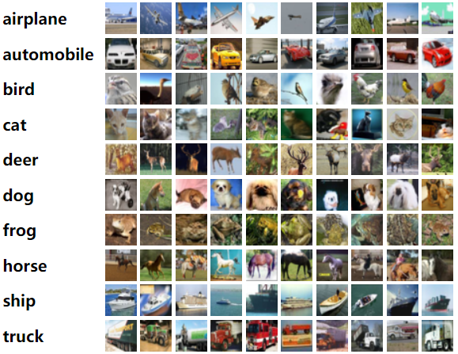
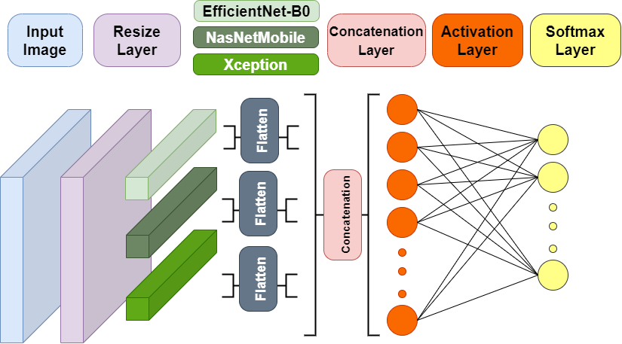
Shallow Ensemble Learning (SEL)
CIFAR-10 Dataset
Model Architecture
Notes:
Differences between our implementation and the paper (all data used? / layers? / optimizer?/ initialization?)

Slide 15
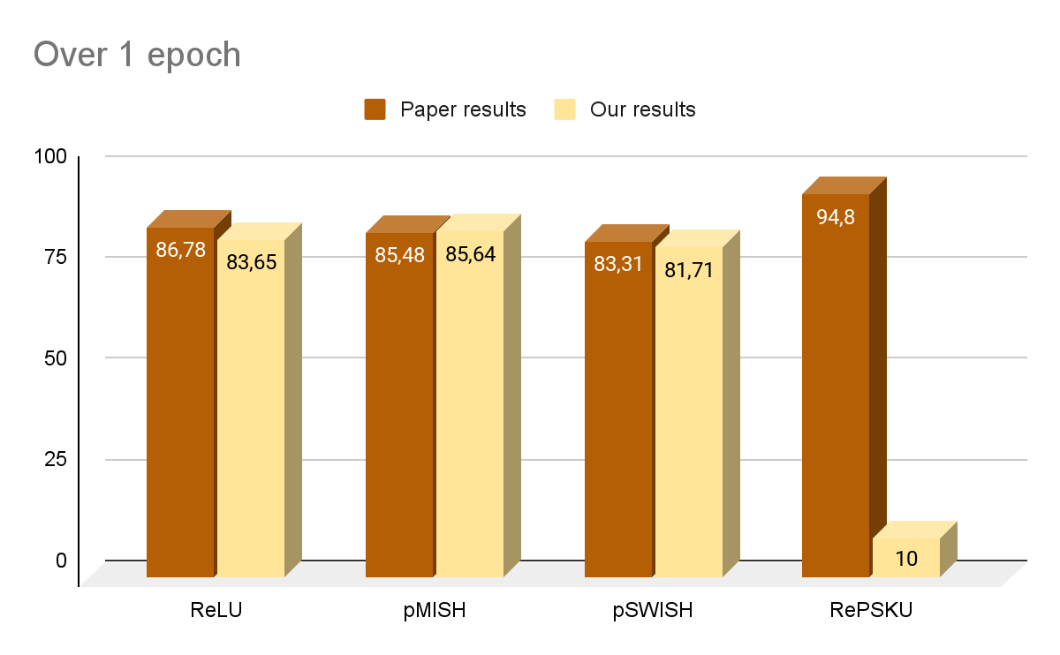
Shallow Ensemble Learning (SEL)
Challenges
Resizing layer
→ Reduce resizing shape
RePSKU not training
→ Attributes equal probabilities
to all classes
Notes:
Differences between our implementation and the paper (all data used? / layers? / optimizer?/ initialization?)

Slide 16
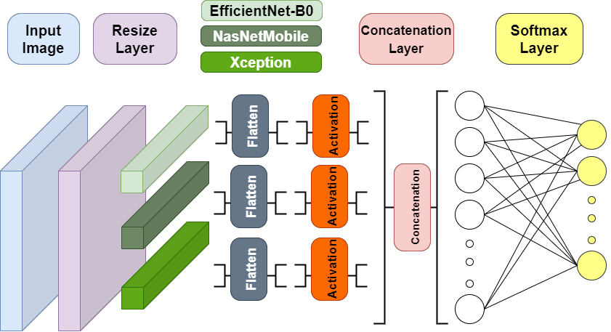
Deep Ensemble Learning (DEL)
CIFAR-10 Dataset
Model Architecture
Notes:
Differences between our implementation and the paper (all data used? / layers? / optimizer? / initialization?)

Slide 17
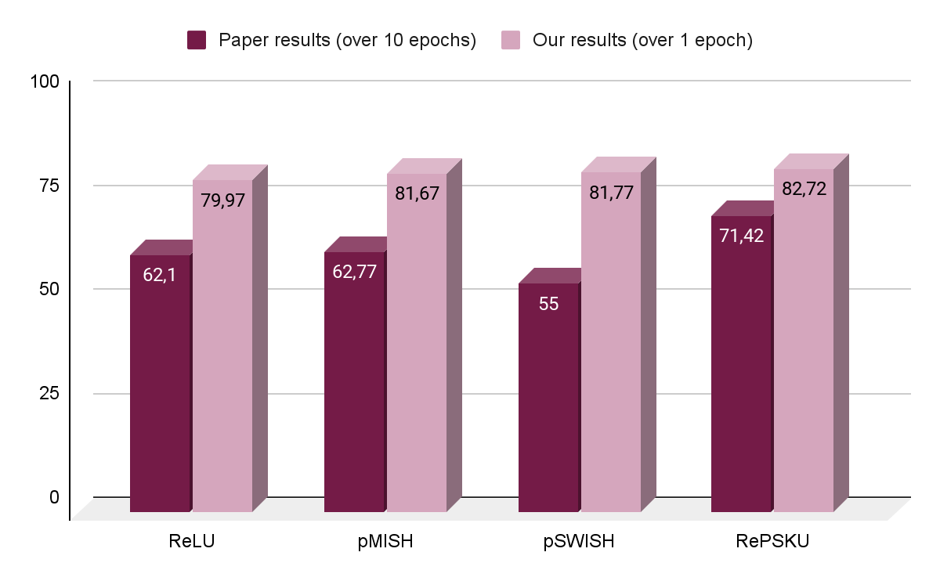
Deep Ensemble Learning (DEL)
Challenges
Resizing layer
→ Reduce resizing shape
Training time
→ Patience
Notes:
Differences between our implementation and the paper (all data used? / layers? / optimizer?/ initialization?)

Slide 18

Takeaway messages
Ambiguities: reproducing the paper’s architectures is not always evident
Hardware limitations: the replication of the paper’s results requires more resources
Using a combination of different activation functions can help capture the various types of relationships between the inputs and outputs and improve the performance of the model
The new parametric nonlinear activation functions can have better performance in certain cases
Notes:
Here are some examples of real-world problems that require a combination of linear and nonlinear activation functions to be modeled effectively:
Image classification: In image classification problems, features in an image may have both linear and non-linear relationships with the class labels. Using a combination of linear and non-linear activation functions can help the model learn these complex relationships effectively.
Speech recognition: In speech recognition problems, the relationships between the speech signals and the corresponding transcriptions are complex and may involve both linear and non-linear interactions. Using a combination of linear and non-linear activation functions can help the model capture these complex relationships.
Financial forecasting: In financial forecasting problems, the relationships between various financial indicators and stock prices can be both linear and non-linear. Using a combination of linear and non-linear activation functions can help the model capture the complex relationships between financial indicators and stock prices.
Predictive maintenance: In predictive maintenance problems, the relationships between various sensor readings and equipment failures can be both linear and non-linear. Using a combination of linear and non-linear activation functions can help the model capture these complex relationships and make accurate predictions.

Slide 19
Thank you for your attention!
Please keep this slide for attribution

Slide 20
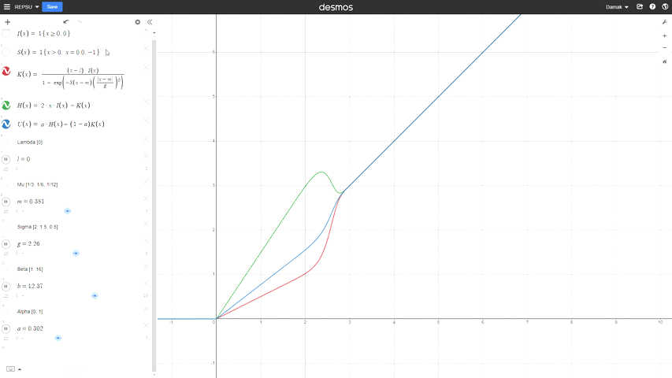
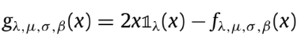

Proposed (parametric) activation functions
RePSKU (RePSU▽)
RePSHU (RePSU△)
RePSU
Notes:
The analytic form of this new neural class involves scale, shift and shape parameters to obtain a wide range of activation shapes, including the standard rectified linear unit (ReLU) as a limit case.

